Slide 1
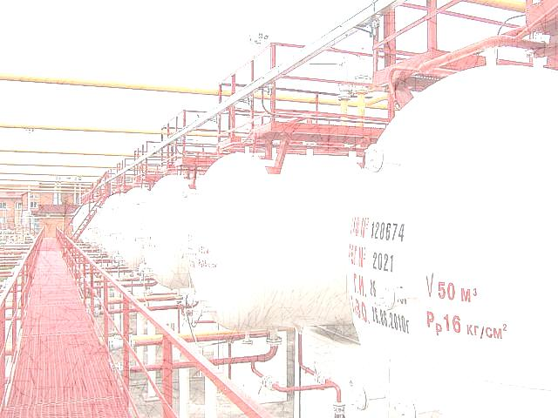
ANALIQ
Measuring values for true cost…

Slide 2
Analiq ultrasonic level metering helps to …
Petrochemical
Gas-processing
Power
Industries
Financial
Natural
Time
Earn & Save
Resources
…by…
Transportation
Storage
Account
Efficient Processing

Slide 3
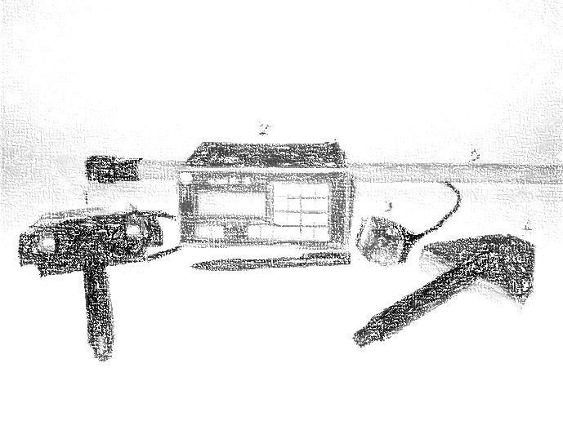
Patented & Certified know-how technology of ultrasonic measuring -
Analiq Mobile
Defines:
Applied to:
Differs with:
Product type
Level
Mass
Volume
Density
Temperature
Liquefied gases
Petrochemicals
Oils
Acids
Alkalis
etc.
Mobile solution
Non-contact application
Commercial precision
Easy & quick operating
Functionality
Safety
Reliability
Efficiency
For products storied & transported in:
tanks, vessels, tubes, reservoirs, etc.

Slide 4
Key performances:
Automatizes accounting and classification of different products while storing or transporting - defining and saving necessary product characteristics, quantities or ratio
Through-wall non-contact measuring – doesn’t require incut, opening or depressurizing tanks, tubes, vessels or other reservoirs
Doesn’t undergo physical or chemical influence of measured environment
Reservoirs walls thick. | 0-50 mm
Level measuring | 20-50 000 mm
Precision | ±1 mm
Measurement time | 3-5 sec.
Uninterrupted work | 200 hrs.
Memory | 999 measurements
Operating temp. | -30 +50 °C
Dimensions | 155x130x75mm
weight | 0,9 kg
Power supp. | 8 X AA
2 SW versions - for usual and “blind” measurements
USB, RS232, radio channel outputs for external devices connection
LCD indicator

Slide 5
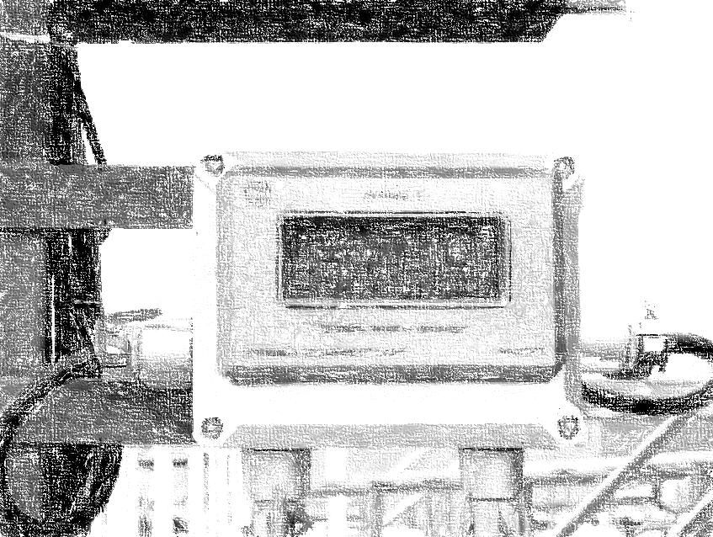
Analiq Stationary
System of same technology and advantages applied where constant measurements required
Same approach of non-contact measurements
Used also for measuring of toxic or pressured liquids without stop of technological process
Particularly actual for liquefied gases due to ability to measure either liquid or steam fraction *
Able to measure boiling liquids *
* Applicable to Analiq M also

Slide 6
Scientific Production Company
“Ultrasonic Advanced Technologies” LLC
We are proud of our…
…achievements…
Developed and patented Analiq systems based on military technology of ultrasound detection
Successfully implemented Analiq systems on numerous enterprises on local and external markets
…partners…
Our suppliers are worldwide esteemed brands
Our clients are the leaders of their industries
…personnel…
Highly qualified and talented Engineers
Experienced Management
…location…
Kyiv, Ukraine

Slide 7
We are Lack of … and looking for…
Respective global brand additional value
Considerable marketing and promotion experience
Additional financial resources for development investments
Access to key consumers on global market
We’ll be appreciate for…
Your professional consideration on the above
Any cooperation propositions
(acquisition, joint ventures, investment projects, etc.)
Your recommendations to subsidiaries or partners
Any of your request for additional information
Any of your answer, recommendations or wishes

Slide 8
With strong cooperation intention,
Viktor Dovgenko
Director General
SPC “UAT” LLC
Ukraine, Kyiv
Tel.: + 38 044 232-22-10
Fax: + 38 044 275 06 08
Cell: + 38 066 723 38 98
www: npfuet.com.ua

